Slide 1
Management of Child and Adolescent TB training
Facilitators:

Slide 2
Welcome and introduction

Slide 3
Overview of Course
Welcome to the Management of Child and Adolescent TB training for health care workers and National TB programme staff in TB high-burden countries.
DAY 1
DAY 2
INTRODUCTION: Training methods
MODULE 1: Epidemiology
MODULE 2: Diagnosis
MODULE 3: Treatment
MODULE 4: Prevention
DAY 3
DAY 4
MODULE 5: Treatment support
MODULE 6: Models for care delivery
MODULE 7: Recording and reporting, TB data
MODULE 8: The role of NTPs
Notes:
Welcome to the Management of Child and Adolescent TB training for health care workers and National TB programme staff in TB high-burden countries.
This is an overview of the content we will cover in the next few days:
Today, we will cover do and introduction and discuss some of the training methods to be used. Then we will cover modules on the epidemiology and diagnosis of TB in children and adolescents.
Tomorrow, we cover Treatment, Prevention, and Treatment support
On day 3, we will look at models for care delivery, recording and reporting, and TB data as well as the role of national TB programmes.
On the last day, we will spend some time looking at at training action plans and next steps.

Slide 4
What form will the training take?
Modules 1-8 over 4 days of training
Interactive lectures, group discussions and activities (case scenarios|role plays)
Presented by master trainers and us!
Let’s work together and participate in all activities!
Your feedback, reflections, suggestions are WELCOME!

Slide 5
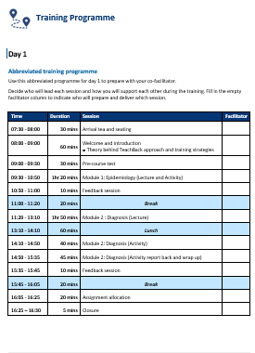
Facilitator Manual
Will guide you through how to deliver a ‘training of trainers’ so that this course may be cascaded to sub-national levels of services at scale.
The manual covers:
Adult learning principles
Training approaches used
Planning of the trainings
Logistics of the trainings
Training programmes: with abbreviated schedules of each day followed by detailed schedules of each session
Notes:
You will receive Facilitator Manual that will guide you through how to deliver a ‘training of trainers’ so that this course may be cascaded down at scale.
Let’s page through briefly and see what’s inside

Slide 6
Training content
Activity
Activity
Activity
Activity
Activity
Activity
Notes:
The content of the course is in the form of PowerPoint presentations designed to be delivered as interactive lectures with frequent opportunities for group discussions.
Most of the lectures are followed by a variety of different activities which will allow the learnings from the lecture to be applied to real life situations.

Slide 7
Adult learning principles
Adult Learning Principle | Training Technique
Adults bring a wealth of knowledge and experience. | Encourage participants to share their knowledge and experiences.
Adults are decision-makers and self-directed learners. | Include problem-solving activities.
Adults have different learning styles that must be respected. | Provide multiple ways for participants to learn the material.
Adults want to participate rather than just listen to a lecture. | Create a participatory learning environment with activities.
Motivated by information/ tasks that are applicable to their jobs. | Relate content to their jobs.
Learn best when content is organised and designed. | Present content in small “chunks” with steps or sequences; build from basic to complex; and provide reinforcement.
Adults expect their time during training to be used carefully. | Follow a realistic time schedule.
Adults feel anxious when participating in a group that makes them look uninformed, either professionally or personally. | Avoid criticism. Acknowledge all participants’ contributions.
Adults learn best in a positive environment where they feel respected and confident. | Create a positive environment by providing positive feedback and showing respect to all participants.
Adults come from different cultures, lifestyles, religious preferences, genders and ages. | Respect all differences and encourage participants to respect each other’s differences as well.
Notes:
Many people think that training adults is the same as teaching students in a traditional school system. But this is not true. Adults learn differently to children and require different training approaches. Knowing how adults learn is critical to the success of your training courses. Using adult learning principles helps us use the right training technique to enhance learning. The table shown here describes some important adult learning principles and training techniques we can use to engage the adult learner.

Slide 8
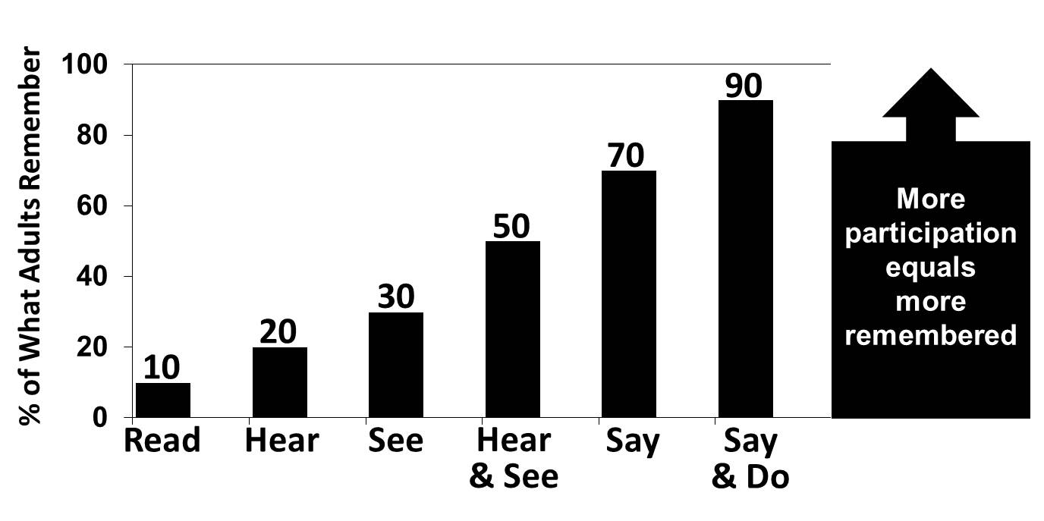
What do adults remember?
Notes:
This graph shows us what adults remember. This has informed the training that we are going to use in this training.
It shows the percentage of what Adults remember according to what form they receive the information in.
If they read information, they retain about 10%,
If they only hear the information, it’s predecited that they will retain about 20% of it.
If they only see it, then the percentage increases to 30%.
If they hear and see it they are expected to retain around 50%.
Creating a participatory training where participants are active and “saying and doing” will help them remember between 70 and 90% of the content.
So, the more participation there is, the more is remembered.

Slide 9
TeachBack method of training
DEMO
Content delivery will be modelled initially by master trainers.
ASSIGN
Content will be shared amongst participant teams.
TRAIN
Participant teams will train their assigned content.
Feedback sessions
Notes:
This is where we introduce the TeachBack method of training that we are going to use during this training.
The ‘Teach-back’ method involves the trainees actively participating in the training process during this course.
The training strategies will be modelled by the master trainers, thereafter, course content will be divided and assigned to teams of participants to prepare, deliver and give and receive feedback on.
Applying this approach in training sessions ensures that participants actively engage with content.
Participants are compelled to understand the material so that they can accurately convey information to their fellow trainees.
A key aspect of this approach is the focussed feedback which follows each lecture and activity.

Slide 10
TeachBack method of training
We play two roles in this training
Course Participant
Trainer
Notes:
Using this TeachBack method will mean that all of us will play two roles in this training.
You will be a course participant for most of the time but you will also have an opportunity to experience being a trainer, when you get to train your portion of the curriculum.

Slide 11
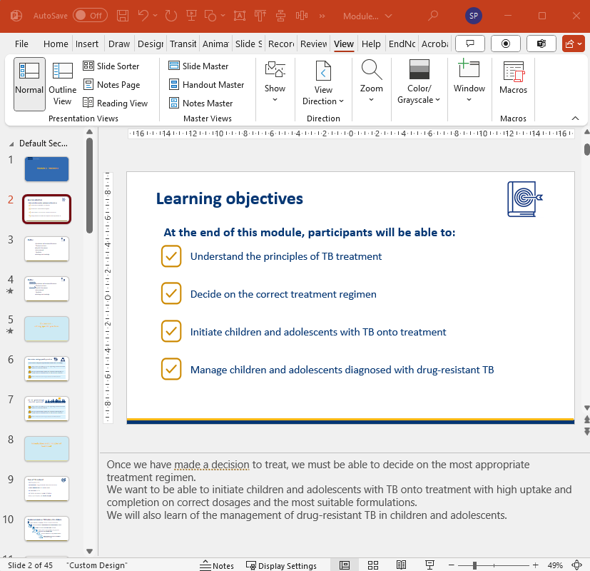
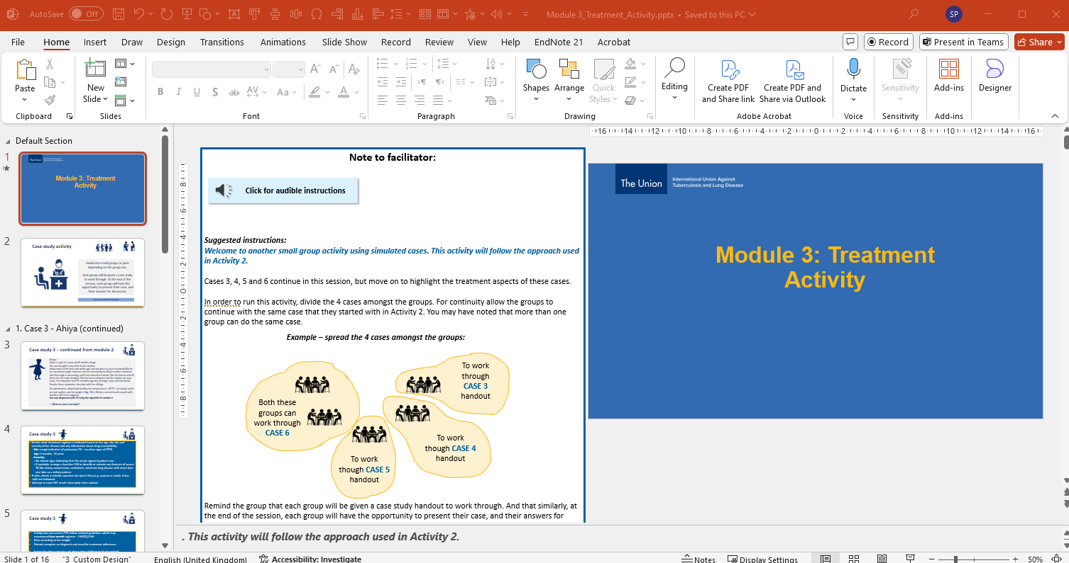
Training materials
TEAM 1
Explanation of slide provided in Notes section
TEAM 2
Explanation and instructions of activities provided in the margins.
Written and audio.
Notes:
At the end of day 1, participants will be divided into small teams and allocated a portion of the training curriculum to facilitate - either an interactive lecture or one of the activities.
The slides in the interactive lecture presentations have more detailed explanations of slide in the notes section below. We recommend that you avoid using these as a verbatim transcript – rather make the presentation your own. Instead, use these notes to gain a better understanding of the content on the slide.
The activity presentations have instructions in the margins of the first slide that will explain how to run the activity. A short audio clip has been included to help here. Click on the little speaker icon to play this when starting to prepare for your session.

Slide 12
Feedback – in our safe learning environment
One of the most important learning points
Opportunity to improve one’s performance
Both in oral and written formats – using a check list
Notes:
As mentioned already, we will have feedback sessions at the end of every lecture or activity. These sessions present a rare and unique opportunity for participants to receive constructive feedback on their training styles from peers and master trainers. It allows participants to learn from one another and grow their facilitation skills whilst covering the content of this course.
We will be using a structured feedback format. There will be an opportunity for self-reflection to start with – what went well and what could possibly be improved on? Then an opportunity for peer-review, using the forms on the next slide.
It is most useful if the reviewer is able to note down specific examples of feedback given. For example: I liked how Ms X encouraged participant contributions, especially when she asked table 3 for their opinion, after she noticed that they were the only table not yet to have had a chance to say something.

Slide 13
Feedback forms – different form for each skill
TeachBack Feedback Form
TeachBack Feedback Form
TeachBack Feedback Form
Notes:
We will be using structured feedback forms in this course – there are different forms for each different skill – lectures and activities like group discussions and roleplays.

Slide 14
Giving feedback
No comparisons please
Feedback should:
Offer positive and encouraging information.
Emphasise what the participant did well.
Offer suggestions for what could be improved
Be
non-judgmental.
It takes
8 - 9 positive comments
1 negative comment.
to undo the damage of
Notes:
When giving feedback, please offer positive and encouraging information
Emphasise what the participant did well.
Offer suggestions for what could be improved.
Participants will not be criticised.
Participants will not be compared to one another.
It takes 8 - 9 positive comments to undo the damage of one negative comment.

Slide 15
Receiving feedback
Ask for specific and descriptive feedback.
Ask clarifying questions to understand the feedback.
Accept the feedback; avoid defending or justifying the behaviour.
Listen and thank the facilitators and participants for sharing their perspectives.
Reflect on the feedback and use it to improve your performance next time.
Notes:
When receiving feedback:
Ask for specific and descriptive feedback
Ask clarifying questions to understand the feedback
Accept the feedback; do not defend or justify the behavior
Listen and thank the facilitators and participants for sharing their perspectives
Reflect on the feedback and use it to improve performance

Slide 16
Benefits of TeachBack
TeachBack can be very empowering:
Integrates training theory with teaching course content.
We can practice training in a safe environment.
We learn from our peers and observe multiple styles of performing a skill.
We become better and more confident (adult) trainers.
Notes:
The TeachBack approach can be very empowering because you as participants can:
Integrate training theory with teaching course content.
Practice training in a safe environment.
Receive feedback on their performance of training skills.
Learn from their peers.
Observe multiple styles of performing a skill.
Develop confidence in training others and become better (adult) trainers.

Slide 17
Ground rules & Parking lot
Notes:
During our face-to-face training, we'll be using a "parking lot" system.
This is a designated space, typically on a flip chart or whiteboard, where we can jot down any questions, comments, or ideas that come to mind during the lecture but may not be immediately addressed.
This helps us stay focused on the current topic while ensuring that all your concerns and queries are noted and will be revisited at the appropriate time.
Using a "parking lot" helps us manage the flow of the session efficiently, ensures that all our participants’ inputs are acknowledged, and allows us to cover all the planned material without getting sidetracked.
Let’s decide together what our ground rules should be as a group… (obtain input from the group and write them down on the flip chart… e.g.: cellphones and laptops away/on silent; one conversation - respect when someone else is talking; punctuality)

